Slide 1
Software Metrics – Part 2 (Estimation Techniques)
Software Quality Engineering
CT051-3-3
Prepared by: xxx First Prepared on: xx-xx-xx Last Modified on: xx-xx-xx
Quality checked by: xxx
Copyright 2004 Asia Pacific Institute of Information Technology

Slide 2
Topic & Structure of the lesson
Introduction to software estimation
Software estimation techniques

Slide 3
Learning Outcomes
By the end of this lecture, YOU should be able to:
  To introduce the fundamentals of software costing and pricing
  To describe three metrics for software productivity assessment
  To explain why different techniques should be used for software estimation
  To describe the principles of the COCOMO 2 algorithmic cost estimation model

Slide 4
What is Software Estimation?
The process of predicting the most realistic amount of effort, cost, and schedule required to develop or maintain software.
Why Estimate?
  To provide a basis for planning and scheduling.
  To determine project feasibility.
  To establish budgets and secure funding.
  To manage stakeholder expectations.
  To assess risks and develop mitigation strategies.

Slide 5
Why is Software Estimation Difficult?
Uncertainty: Software development is often a journey into the unknown.
Changing Requirements: Requirements frequently evolve throughout the project lifecycle.
Human Factors: Developer skill, team dynamics, and individual productivity vary.
Lack of Historical Data: Insufficient data from past projects can hinder accurate predictions.
Complexity: Intricate systems are harder to break down and estimate.
External Dependencies: Reliance on third-party components or services.
Optimism Bias: Tendency to underestimate effort and overestimate productivity.

Slide 6
Goals of Software Estimation
The primary goals of effective software estimation are to:
  Improve Planning: Provide realistic inputs for project schedules and resource allocation.
  Enable Budgeting: Determine the financial resources required for the project.
  Manage Risk: Identify potential issues early and plan for contingencies.
  Support Decision Making: Help stakeholders make informed choices about project scope, features, and priorities.
  Enhance Communication: Foster a clear understanding among team members and stakeholders.

Slide 7
Key Estimation Parameters
When estimating software projects, we typically focus on:
  Size: The magnitude of the software to be developed (e.g., Lines of Code, Function Points, Story Points).
  Effort: The amount of labor required to complete the project (e.g., Person-months, Person-hours).
  Cost: The total financial expenditure (e.g., Salaries, hardware, software licenses).
  Schedule: The duration required to complete the project (e.g., Calendar months, weeks).
Relationship: Size → Effort → Cost & Schedule

Slide 8
Software Estimation Techniques - Overview
Expert-Based Techniques:
  Expert Judgment
  Delphi Technique
Analogy-Based Techniques:
  Analogy Estimation
Decomposition Techniques:
  Work Breakdown Structure (WBS)
  Function Point Analysis (FPA)
Algorithmic Models:
  COCOMO (Constructive Cost Model)

Slide 9
Expert Judgment
Relies on the experience and intuition of one or more experts who have worked on similar projects.
How it works: Experts provide estimates based on their knowledge.
Advantages
  Quick and inexpensive.
  Can be highly accurate if experts are truly knowledgeable and objective.
  Useful for novel or ill-defined projects where data is scarce.
Disadvantages
  Highly subjective and prone to bias (e.g., optimism bias).
  Accuracy depends heavily on the expert's experience and objectivity.
  Difficult to justify or replicate.

Slide 10
Delphi Technique
A structured communication technique designed to obtain expert consensus on estimates through a series of anonymous questionnaires.
Process:
  Coordinator presents problem to experts.
  Experts provide individual, anonymous estimates.
  Coordinator compiles and summarizes results (e.g., median, range).
  Summary and rationale for extreme estimates are shared back to experts.
  Experts revise their estimates, considering others' views, still anonymously.
  Repeat steps 3-5 until a consensus or stable range is reached.
Advantages
Reduces bias, encourages independent thought, promotes consensus.
Disadvantages
Time-consuming, requires skilled coordinator.

Slide 11
Analogy-Based Estimation
Estimates are derived by comparing the current project to one or more similar, completed projects.
How it works:
  Identify a past project that is similar in scope, technology, and team size.
  Adjust the past project's effort/cost based on differences with the current project.
  Factors for adjustment: size, complexity, technology, team experience, tools, etc.
Advantages
  Based on historical data, potentially more objective than pure expert judgment
  Relatively easy to understand and apply.
Disadvantages
  Finding truly analogous projects can be challenging.
  Differences between projects can lead to inaccuracies if not carefully adjusted.
  Requires good historical data.

Slide 12
Algorithmic Models
Use mathematical formulas or algorithms to estimate effort, cost, and schedule based on project characteristics (parameters).
How it works:
Inputs (e.g., size, complexity drivers) are fed into a model, which then calculates the output.
Examples:
  COCOMO (Constructive Cost Model): One of the most widely used models.
  Function Point-based models
Advantages
  Objective and repeatable.
  Can be calibrated with historical data for better accuracy.
  Useful for "what-if" analysis.
Disadvantages
  Requires accurate input parameters.
  Models may not fit all project types perfectly.
  Can be complex to set up and understand.

Slide 13
COCOMO Model (Constructive Cost Model)
Estimates software development effort and schedule based on size (KLOC - Kilo Lines of Code).
Versions:
  COCOMO 81: Original model.
  COCOMO II: Updated for modern software development practices (e.g., object-oriented development, reuse).
Modes of Development (COCOMO 81 - Simplified):
  Organic: Small, simple projects with experienced teams.
  Semi-Detached: Medium-sized projects with mixed experience.
  Embedded: Complex, large-scale projects with tight constraints.

Slide 14
Function Point Analysis (FPA)
A method for measuring the "functional size" of a software system from the user’s perspective,
independent of the technology used.
How it works:
Identifies and counts five types of user functions:
    External Inputs (EI)
    External Outputs (EO)
    External Inquiries (EQ)
    Internal Logical Files (ILF)
    External Interface Files (EIF)
Assigns complexity weights to each count.
Applies a "Value Adjustment Factor" (VAF) based on 14 general system characteristics.
Calculates Unadjusted Function Points (UFP) and then Adjusted Function Points (AFP).
Advantages
Technology-independent, focuses on user value, good for early estimates.
Disadvantages
Can be subjective in counting, requires trained analysts.

Slide 15
Object points
Object points (alternatively named application points) are an alternative function-related measure to function points when 4GLs or similar languages are used for development.
Object points are NOT the same as object classes.
The number of object points in a program is a weighted estimate of
  The number of separate screens that are displayed;
  The number of reports that are produced by the system;
  The number of program modules that must be developed to supplement the database code;

Slide 16
Object point estimation
Object points are easier to estimate from a specification than function points as they are simply concerned with screens, reports and programming language modules.
They can therefore be estimated at a fairly early point in the development process.
At this stage, it is very difficult to estimate the number of lines of code in a system.

Slide 17
Top-down and bottom-up estimation
Top-Down Estimation:
  Overall project estimate is broken down into smaller components.
    When to use:
      Early in the project lifecycle, for high-level feasibility studies, when detailed requirements are not yet available.
  Pros: Quick, provides a high-level view.
  Cons: Less accurate, can miss details.
Bottom-Up Estimation:
  Detailed estimates for individual tasks are aggregated to form a total project estimate.
    When to use:
      Later in the project, when requirements are well-defined, for detailed planning.
  Advantages
    More accurate, forces detailed planning.
  Disadvantages
    Time-consuming, requires detailed information.
Best Practice: Use both! Start with top-down, then refine with bottom-up as details emerge.

Slide 18
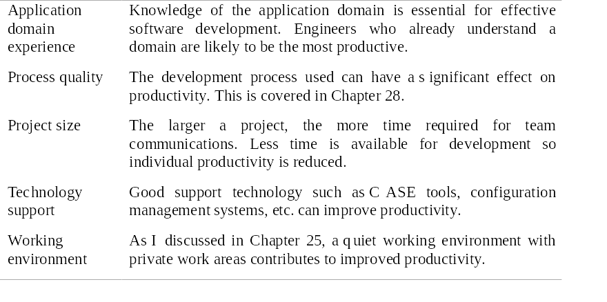
Factors affecting productivity

Slide 19
Quality and productivity
All metrics based on volume/unit time are
flawed because they do not take quality into
account.
Productivity may generally be increased at the
cost of quality.
It is not clear how productivity/quality metrics
are related.
If requirements are constantly changing then an approach based on counting lines of code is not meaningful as the program itself is not static;

Slide 20
Changing technologies
Changing technologies may mean that previous estimating experience does not carry over to new systems
  Distributed object systems rather than mainframe systems;
  Use of web services;
  Use of ERP or database-centred systems;
  Use of off-the-shelf software;
  Development for and with reuse;
  Development using scripting languages;
  The use of CASE tools and program generators.

Slide 21
Best Practices in Software Estimation
Use Multiple Techniques: Combine approaches (e.g., expert judgment + analogy + parametric model) for cross-validation.
Involve the Team: Engage the development team in the estimation process for better buy-in and accuracy.
Document Assumptions: Clearly state all assumptions made during estimation.
Track Actuals: Compare estimates with actual effort/cost to improve future predictions.
Re-estimate Regularly: Refine estimates as new information becomes available and the cone of uncertainty narrows.
Include Contingency: Add a buffer for unforeseen risks and changes (e.g., 10-20% of the estimate).
Communicate Clearly: Present estimates as ranges, not single-point numbers, and explain the underlying assumptions.

Slide 22
Common Estimation Pitfalls
Ignoring Risks: Failing to account for potential problems and their impact.
Over-optimism: Underestimating effort due to a desire to please stakeholders or internal bias.
Scope Creep: Uncontrolled expansion of project requirements without adjusting estimates.
Lack of Historical Data: Estimating without a basis in past project performance.
Estimating in Isolation: Not involving the people who will do the work.
Confusing Effort with Calendar Time: Assuming person-months directly translate to calendar months (ignoring holidays, meetings, etc.).
Not Documenting Assumptions: Leading to misunderstandings and disputes later.

